Slide 1
3D Printing
Student’s Name
Institution Affiliation

Slide 2
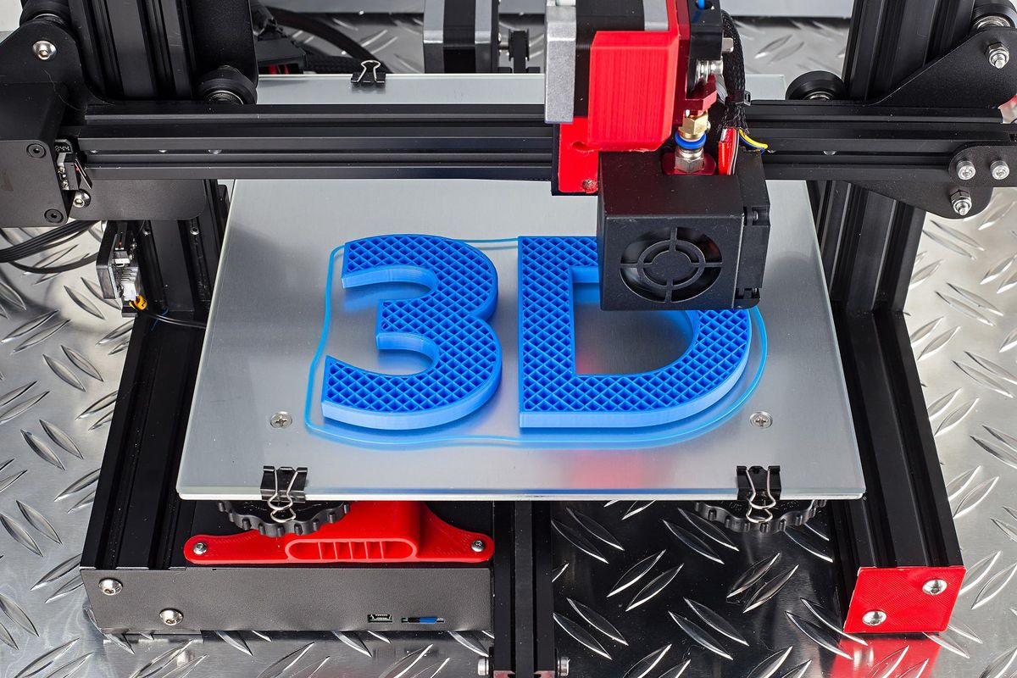
Introduction
3D printing is one of the most revolutionary technologies of the 21 century.
It Provides consistent product quality.
It involves layering materials such as composites, plastics, and biomaterials to develop objects that vary in color, rigidity, shape, and size.
. It enables individuals to create complex shapes using less material compared to conventional manufacturing techniques.

Slide 3
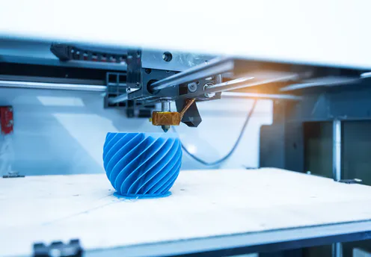
Types of 3D Printing
Fusion deposition modeling.
Stereolithography.
Thermal inkjet printing.
Laser sintering.

Slide 4
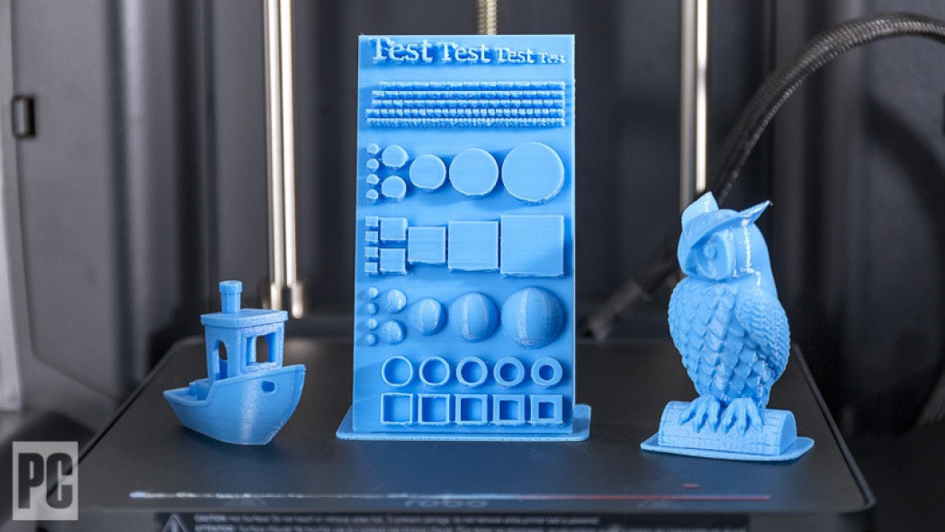
How Does it Work?
Use diverse printer technologies, resolutions, speeds, and thousands of materials.
It develop a 3D object in any shape, as defined by the computer-aided design file.
It starts by developing a graphic model of an item to be printed digitally.
It constructs a one-layer 3D model at a time.

Slide 5
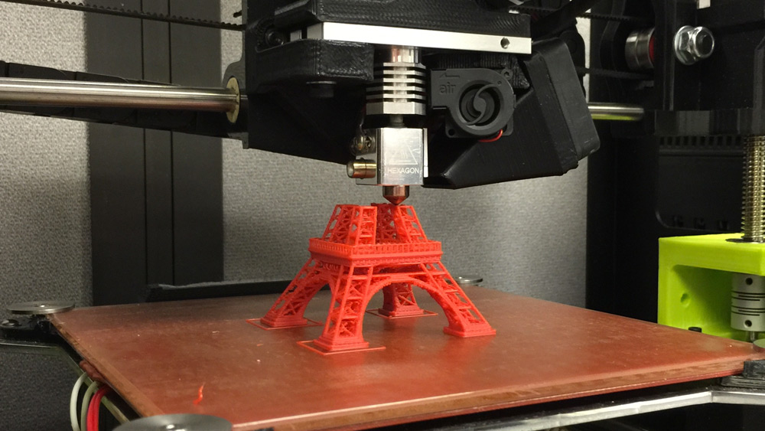
Step in 3D Printing Procedures
3D modeling.
Slicing the model.
Deposition of layers of molten plastic or powder.
Develops the item's basis moving the pattern.

Slide 6
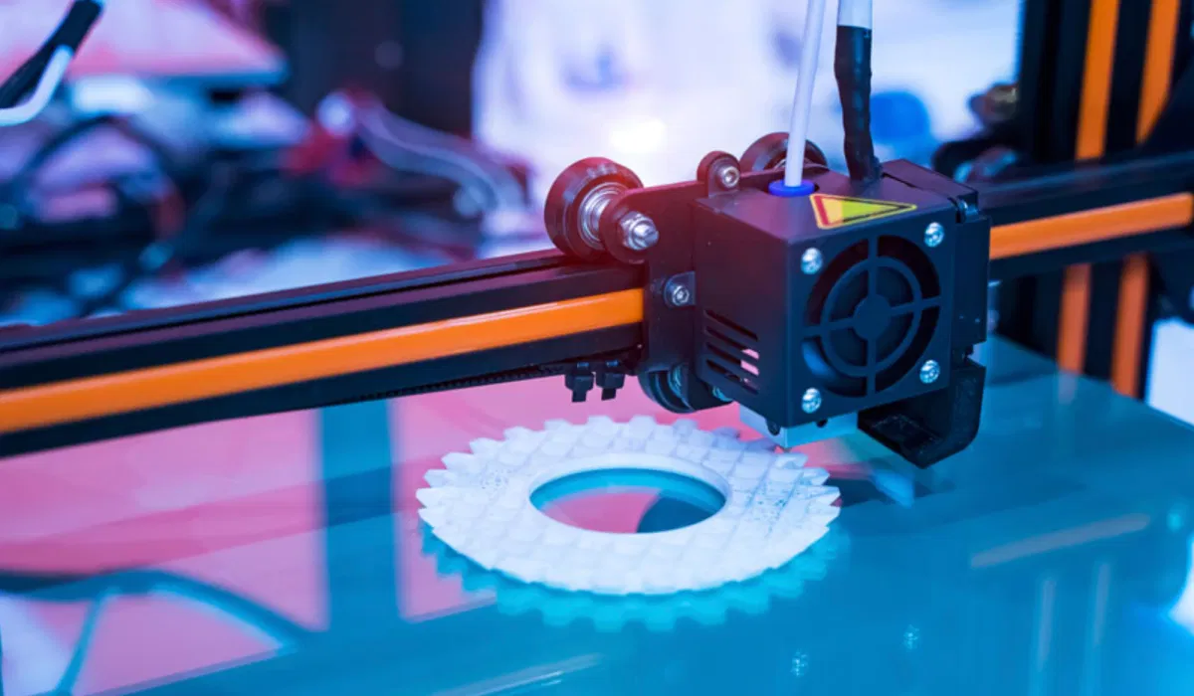
Business Today
Revolutionizing large markets such as the automobile, architectural and medical industries.
Currently, most healthcare facilities have used 3D offset lithography to provide their personnel with much required protective equipment and ventilators to confront COVID-19.
Organizations globally employ 3D printers in developing their prototypes within a short time rather than wasting resources and time in development and research.
The aviation domains use 3D printing in multiple ways, like printing cobalt-chrome fuel nozzles for aircraft engines.

Slide 7
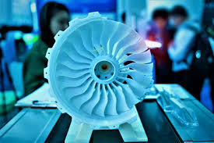
Business Today Cont'd
Utilized in construction where some companies print parts prefab while others do it on-site.
Municipalities and nonprofits globally are opting for 3D lithography to resolve the global crisis of homeless.
Consumer products like footwear, eyewear, and jewelry have also been printed in 3D.
Learning institutions globally employ 3D printers to create hands-on learning in the classroom by printing robotic pieces and three-dimensional dinosaurs.
3D laser printers are employed in the food sector to craft burgers, pizza, and gingerbread houses through mind-blowing technology.

Slide 8
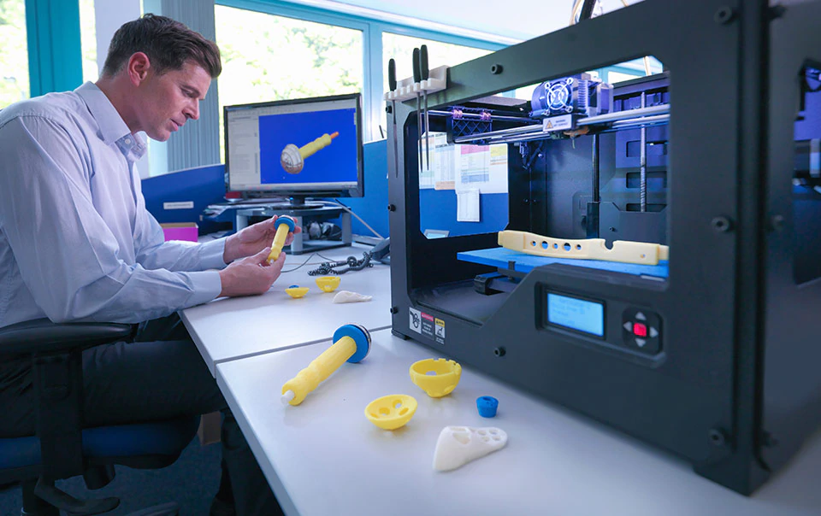
Business in the Future
It enables fast and improved output quality, tangible and customized designs, and cost-effectiveness.
3D printers are flexible, fast, and precise, enabling them to guarantee a moral nature in the future of mass production.
The prospect of space tourism will depend on 3D made rockets that are custom-printed through a branded alloy metal to maximize payload capability and reduce assembly time.
. 3D food printers are expected to empower the global population.
3 D printing will revolutionize home construction, making it more efficient and cheaper.

Slide 9
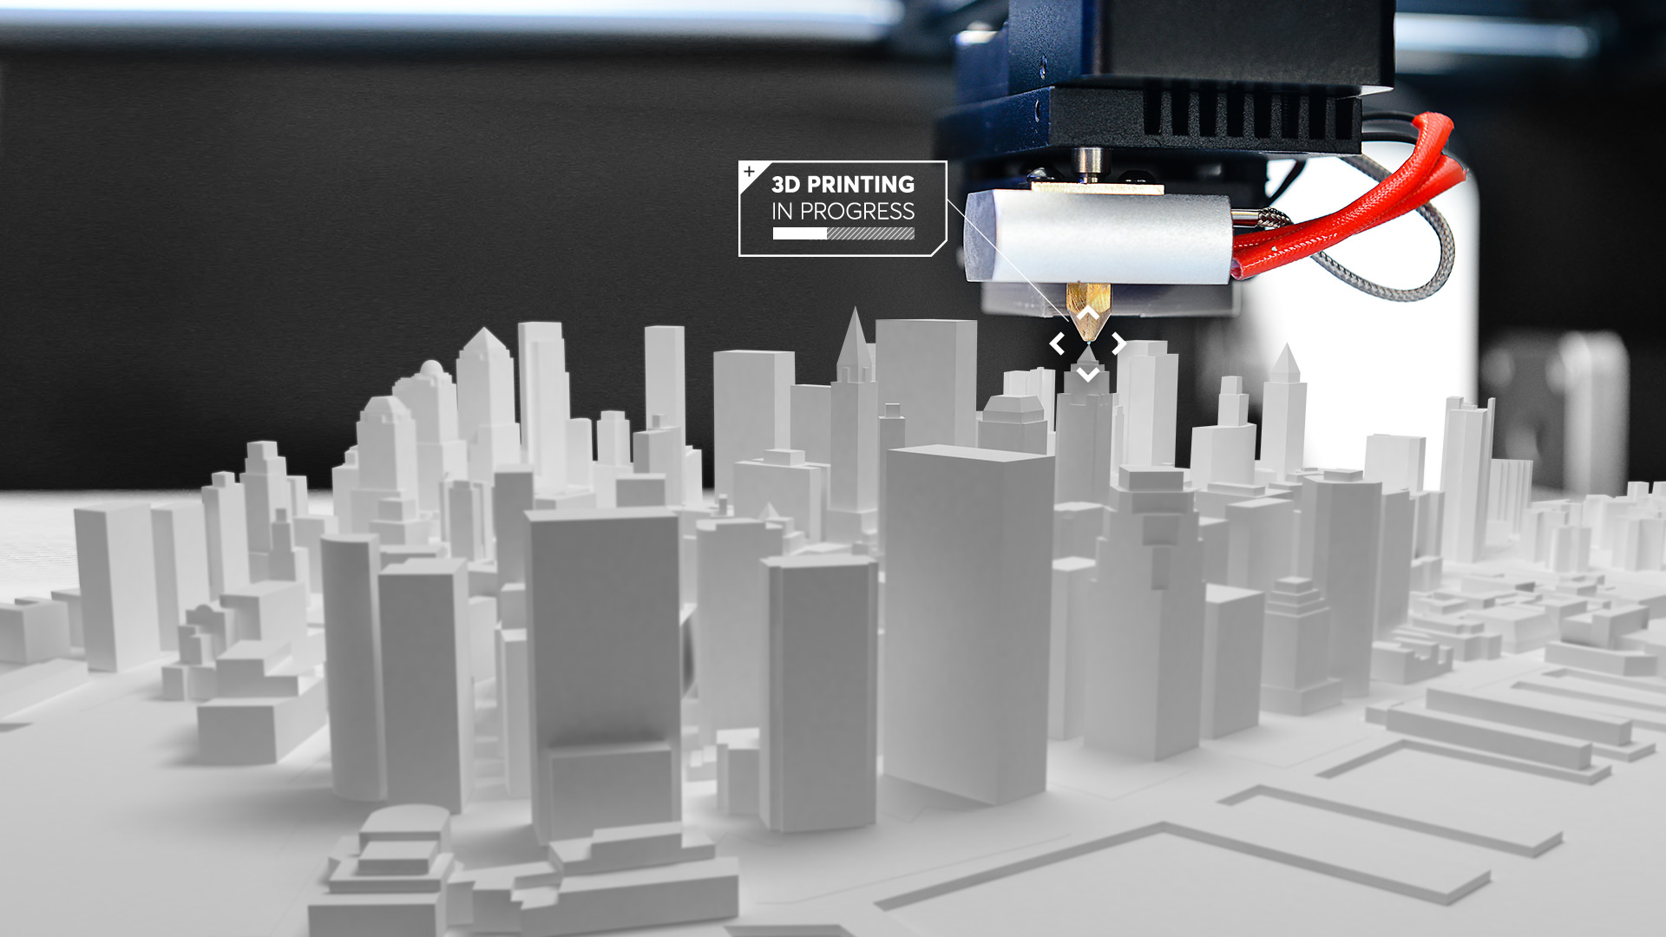
Human Today
Regulatory issues can play an enormous factor in bio-printing.
3D printing has benefited the prosthetics domain by developing imitation of hands, arms, and legs for a cheaper cost.
3 D printing enables essential and new medical tools to get into the hands of individuals who require them.
Scientists have successfully 3D printed a mini human heart from stem cells.
3 D lithography is deployed to create substantial prosthodontics approaches.
It is deployed in eyewear frames since a person's measurements are easy to process in the end product.

Slide 10
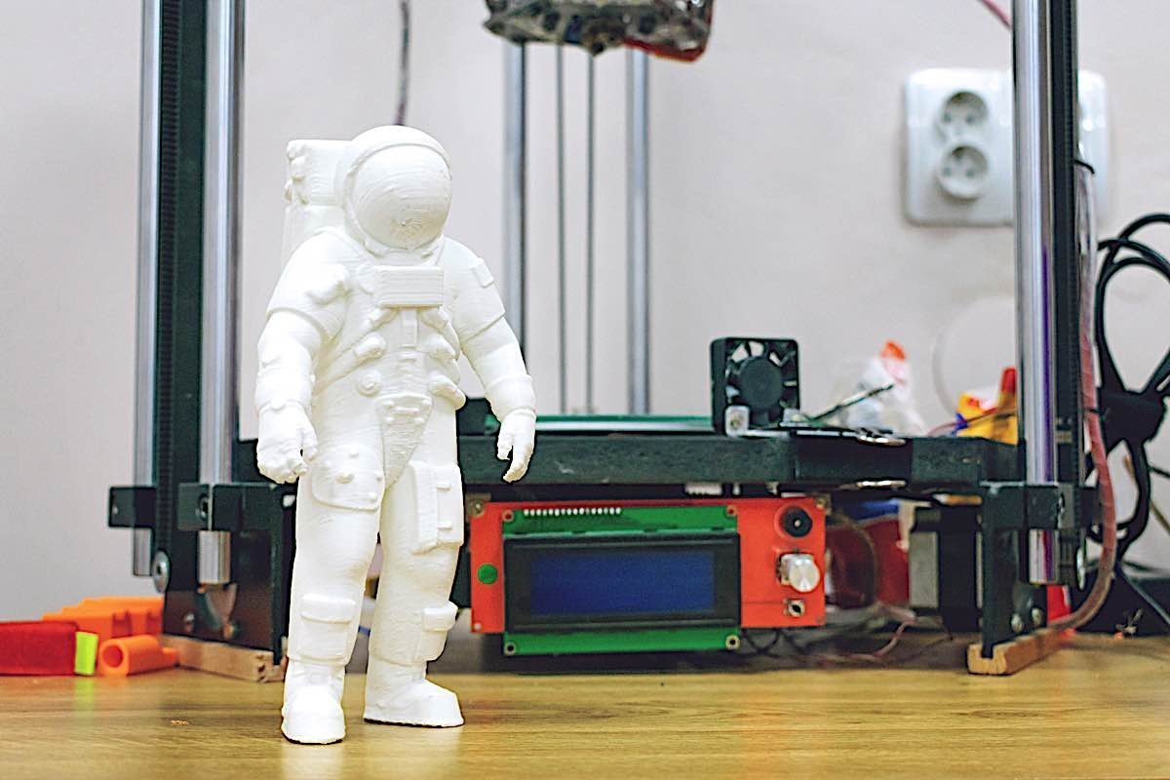
Human Future
In the future, more complex structures will be possible for medical research.
3D bioprinting may be one of the most significant medical developments of all time.
3D printers will be used to create working organs for the patients waiting for transplants.
3D printed heart will function inside an animal or a human.
3D scan of patients will help in developing custom-built prosthetics.
Customized bone replacements will be done through 3D printing.

Slide 11
References
Dawood, A., Marti, B. M., Sauret-Jackson, V., & Darwood, A. (2015). 3D printing in dentistry. British dental journal, 219(11), 521-529.
Martin, J. H., Yahata, B. D., Hundley, J. M., Mayer, J. A., Schaedler, T. A., & Pollock, T. M. (2017). 3D printing of high-strength aluminum alloys. Nature, 549(7672), 365-369.
Paul, G. M., Rezaienia, A., Wen, P., Condoor, S., Parkar, N., King, W., & Korakianitis, T. (2018). Medical applications for 3d printing: Recent developments. Missouri medicine, 115(1), 75.
Sakin, M., & Kiroglu, Y. C. (2017). 3D Printing of Buildings: Construction of the Sustainable Houses of the Future by BIM. Energy Procedia, 134, 702-711.

